Slide 1

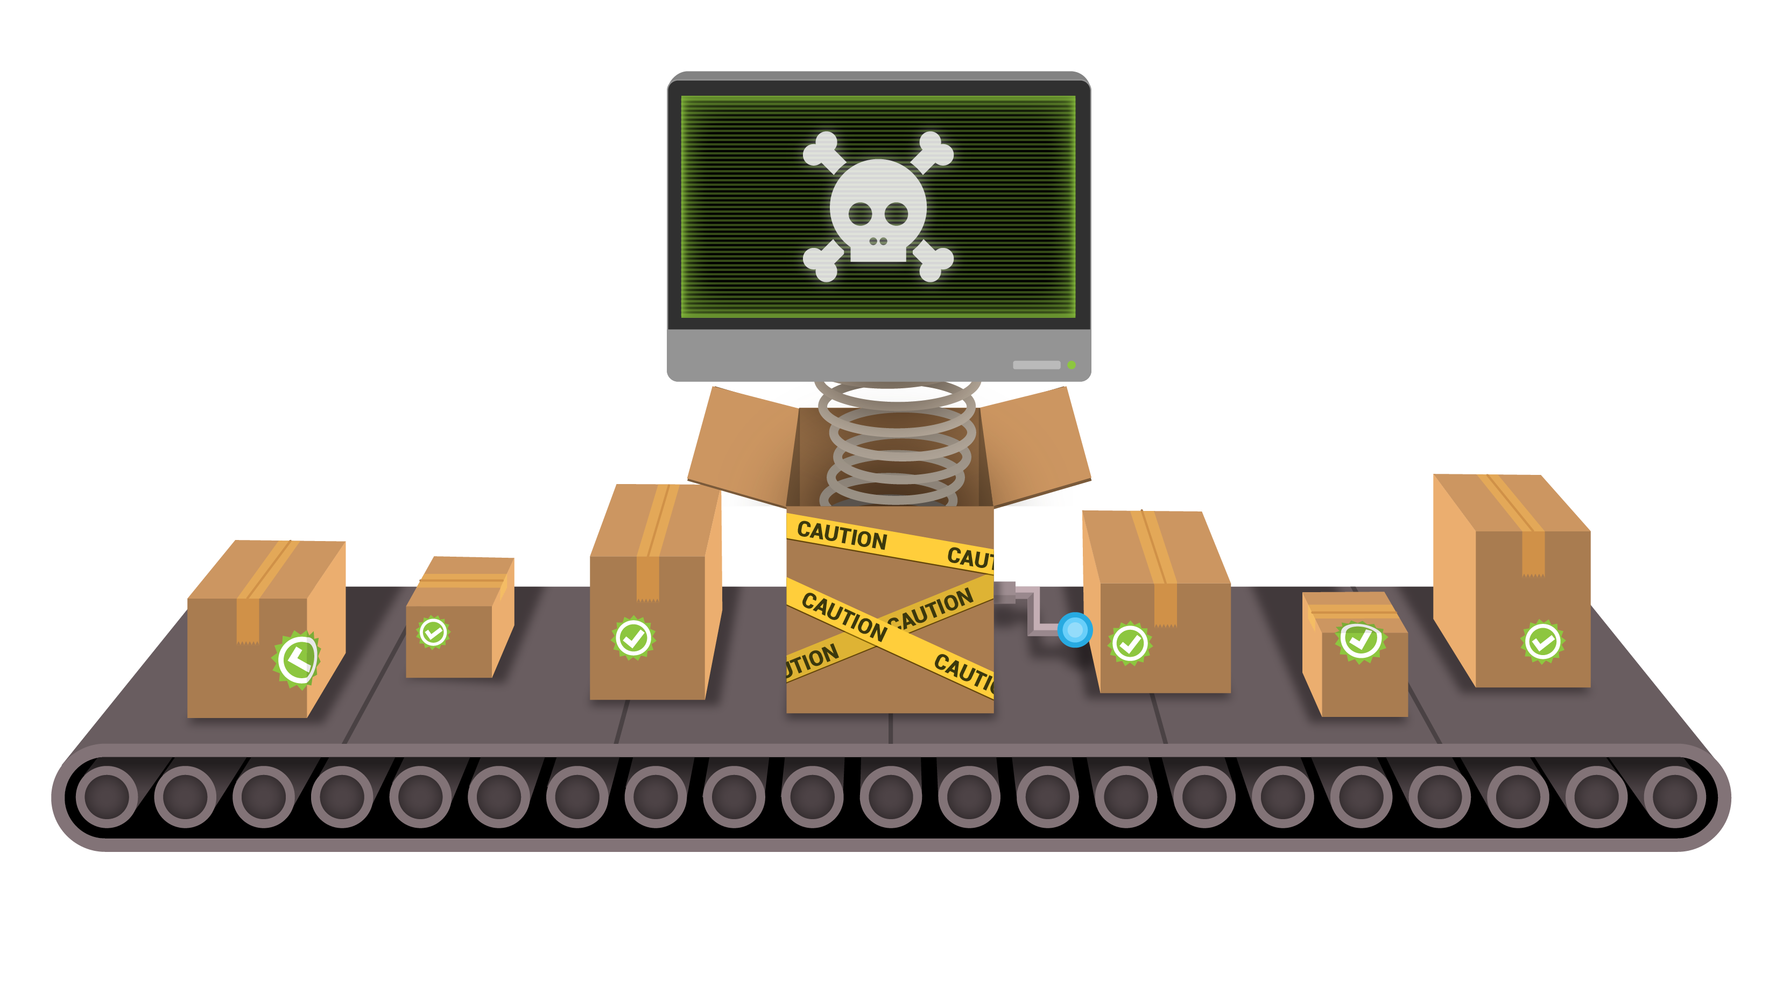
Surprise Supplies!
Paul Rascagneres - Security Researcher
Warren Mercer – Security Researcher

Slide 2
Agenda
About Us
Introduction
Example 1: Nyetya & M.E.doc
Example 2: CCleaner
Conclusion

Slide 3
About Us

Slide 4
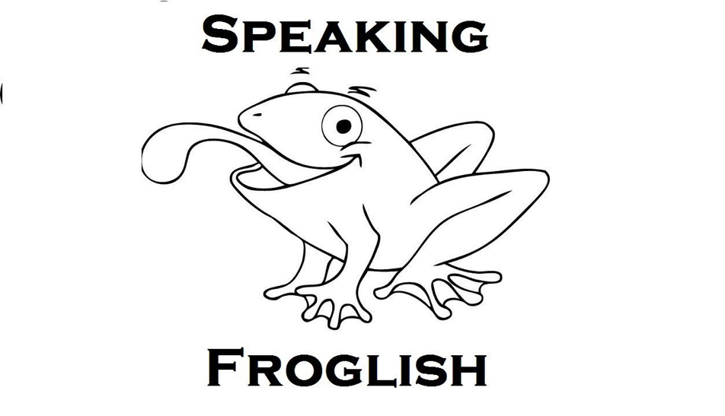
whoami
Paul Rascagneres – prascagn@cisco.com // @r00tbsd
Security Researcher at Cisco Talos
Malware & APT hunter for more than 8 years…
Co-Organizer of Botconf https://www.botconf.eu/
Notes:
Paul

Slide 5

whoami
Warren Mercer – wamercer@cisco.com // @SecurityBeard
Security Researcher at Cisco Talos
I like looking at malware and finding it ☺
NetSec, Malware Analysis, Threat Intelligence.
Co-Founder of BSides Belfast
Notes:
Warren

Slide 6
Introduction

Slide 7
Nyetya Ransomware Attack

Slide 8
It started with a phone call…

Slide 9
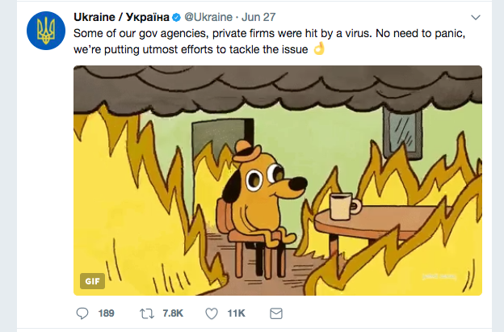
Actual Tweet…

Slide 10
What and Where of starting
The information we received
Ransomware
It appears to be targeting every org in Ukraine.
Effectiveness compared to a flash flood
Infection and delivery vector unknown.

Slide 11

What is M.E. Doc?
Windows .Net app used for tax processing.
Auto Update functionality within app.
Used in various large companies throughout the world.
Has now become the most famous company in Ukraine ☺

Slide 12
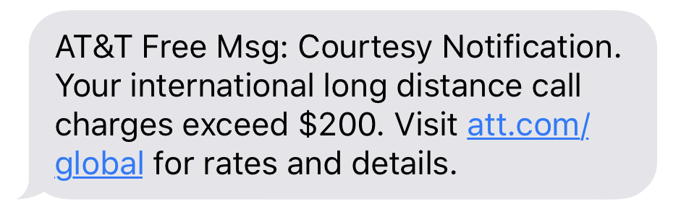
How much communication did we do?

Slide 13
M.E. Doc Timeline

Slide 14
M.E.Doc Timeline
April 14, 2017
01.175-10.01.176 version of MeDoc is released with a backdoor.
May 15, 2017
01.180-10.01.181 version of MeDoc is released with a backdoor.
June 22, 2017
01.188-10.01.189 version of MeDoc is released with a backdoor

Slide 15
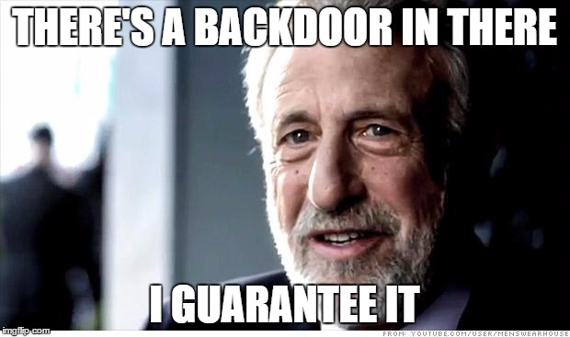
Someone say Backdoor?

Slide 16
The Backdoor
Contacts ‘upd.me-doc.com.ua’ every 2 mins
Retrieve email data from local me-doc
Wait for & execute commands
These commands almost certainly used to
distribute Nyetya.
Notes:
The back door causes the tax accounting software to check is the software update server is a proxy.
If it is, then the backdoor retrieves email data from the local installation of the tax software, and waits for commands issued by the proxy.
These commands were almost certaily used to distribute Nyetya.

Slide 17
The Backdoor
Steal SMTP credentials and store them in registry

Slide 18
The Backdoor

Slide 19
M.E.Doc Timeline
April 14, 2017
01.175-10.01.176 version of MeDoc is released with a backdoor.
June 27, 2017
8:59:14 UTC
Malicious actor used stolen credentials and “su” to obtain root privileges on the update server.
12:31:12 UTC
The last confirmed proxy connection to OVH is observed. This marks the end of the active infection period.
12:33:00 UTC
The original server configuration is restored.
May 15, 2017
01.180-10.01.181 version of MeDoc is released with a backdoor.
Between 9:11:59 UTC and 9:14:58 UTC
The actor modifies the web server configuration to proxy to an OVH server.
14:11:07 UTC
Received SSH disconnect from Latvian IP 159.148.186.214
June 22, 2017
01.188-10.01.189 version of MeDoc is released with a backdoor
9:14:58 UTC
Logs confirm proxied traffic to OVH.
19:46:26 UTC
Third Party Hosting Provider is wiped using “dd if=/dev/zero”, filling the hard drive with 0x00.

Slide 20
Nyetya Ransomware?
Worm capabilities
Credential Stealing
Ransomware (disk/files)

Slide 21

Propagation
Scans IP subnet
139 TCP
WMI
Perfc.dat
PSEXEC
ETERNALBLUE
ETERNALROMANCE

Slide 22
Malware Credential Stealing
Command line
Modified version of Mimikatz pen testing tool.
Credentials passed over a named pipe.
Malware collects stolen credentials as it propagates.
Collects current user token via Windows API.
C:\WINDOWS\TEMP\561D.tmp, \\.\pipe\{C1F0bf2d-8c17-4550-af5a-65a22c61739c}
rundll32.exe C:\Windows\perfc.dat,#1 60 "username:password”

Slide 23
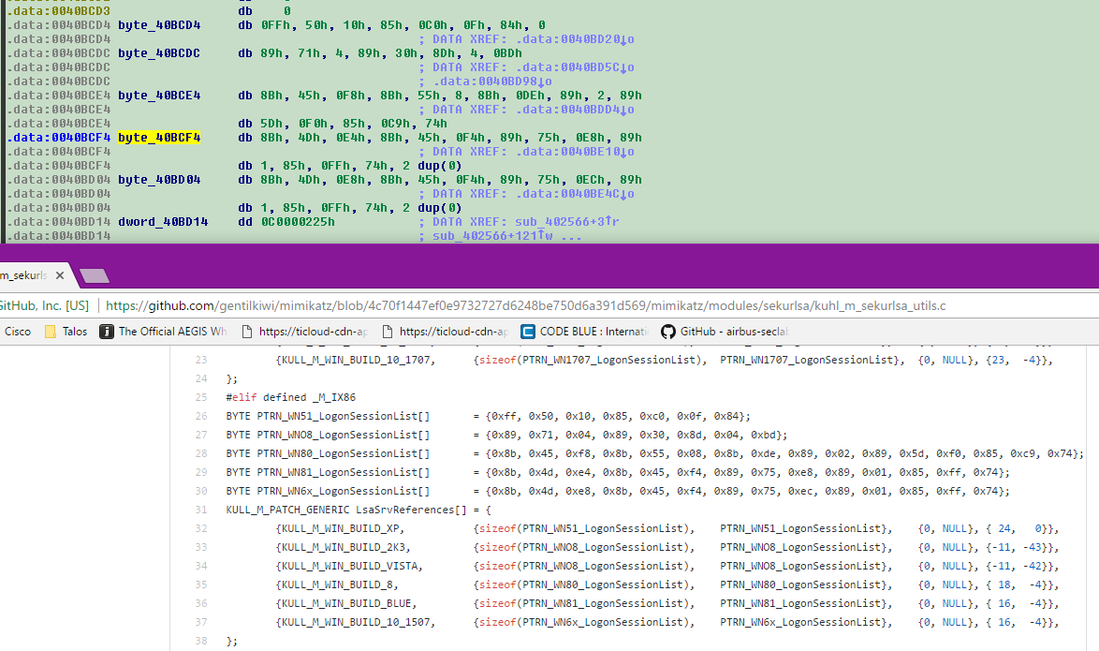

Slide 24
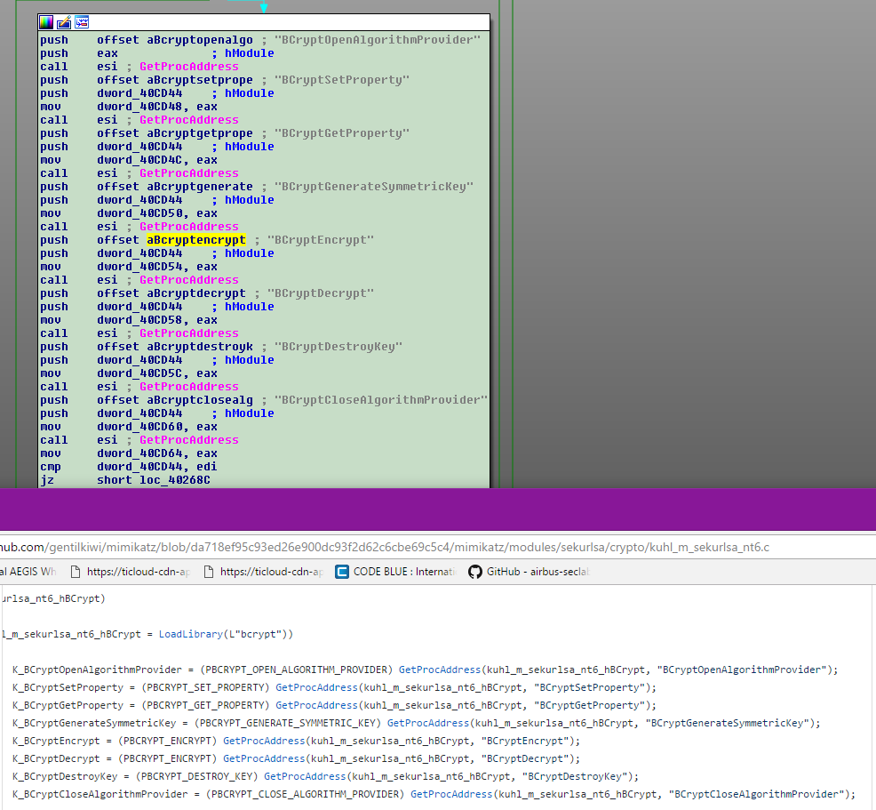

Slide 25
Propagation
If MS17-010 not applied:
Trigger EB or ER exploits.
Installs modified DP backdoor.
Installs perfc.dat, executes as a dll.
ETERNALBLUE
MODIFIED
DOUBLEPULSAR
Perfc.dat
ETERNALROMANCE
DoublePulsar – modified command codes
modified response codes
modified response location in SMB packet

Slide 26
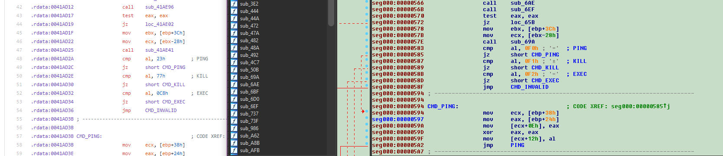
DoublePulsar Modifications

Slide 27
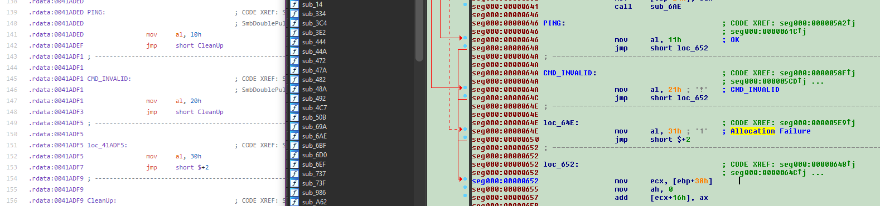
DoublePulsar Modifications

Slide 28
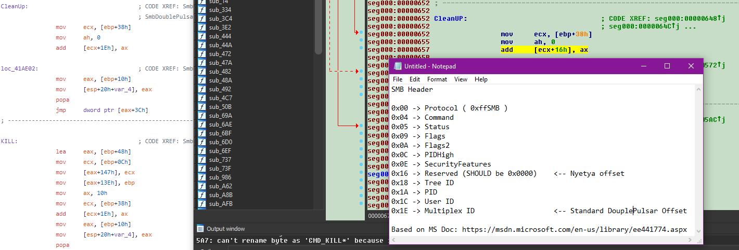
DoublePulsar Modifications

Slide 29
Propagation
Drops PsExec as dllhost.dat.
Uses stolen user token.
Connects to new machine (IP: w.x.y.z).
Installs perfc.dat, executes as a dll.
PSEXEC
Perfc.dat
C:\WINDOWS\dllhost.dat \\w.x.y.z -accepteula -s -d C:\Windows\System32\rundll32.exe C:\Windows\perfc.dat,#1

Slide 30
Propagation
Uses stolen username & password.
Connects to new machine (IP: w.x.y.z).
Installs perfc.dat, executes as a dll.
WMI
Perfc.dat
Wbem\wmic.exe /node:"w.x.y.z" /user:"username" /password:"password" "process call create "C:\Windows\System32\rundll32.exe \"C:\Windows\perfc.dat\" #1"
Notes:
Windows Management Instrumentation

Slide 31
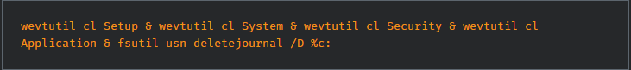
Encryption Process
Escalate privileges of current user
ETERNALBLUE
ETERNALROMANCE
PSEXEC
Schedule reboot in 1hr (SchTasks)
WMI
Destroy MBR on PhysicalDrive0
(if SeDebugPriv or SeShutDownPriv)
** OR **
Destroy first 10 disk sectors
Encrypts files
RSA 2048
Final log clean up

Slide 32
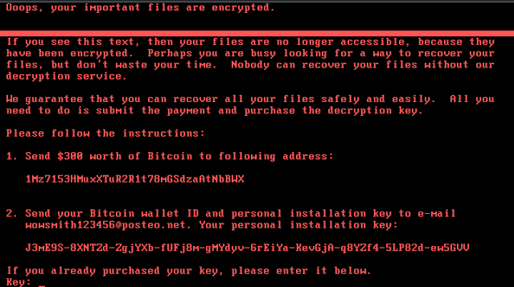
Payload

Slide 33
Genuine Ransomware?
Single bitcoin wallet means difficult to follow who has paid.
Single contact email address, now blocked
you can’t contact the criminals even if you want to.
If admin, MBR is overwritten.
If MBR not overwritten, wipes first 10 disk sectors.
If you have software “avp.exe” running, wipes first 10 disk sectors.

Slide 34
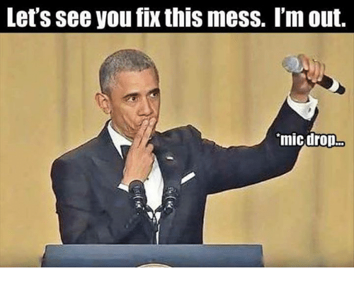
Mic Drop

Slide 35

Example 2: CCleaner

Slide 36
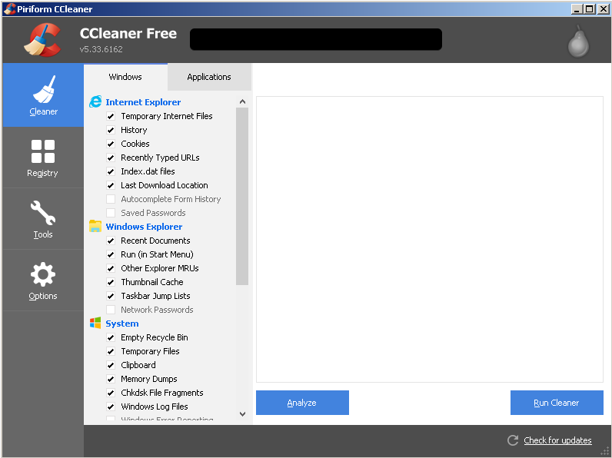
What is CCleaner?
Notes:
Paul

Slide 37
What is CCleaner?
Notes:
Paul

Slide 38
“Yet another patched legit binary” … BUT
likely an attacker compromised a portion of development or build environment
Leveraged access to insert malware into the CCleaner build that was released and hosted by the organization
Notes:
Paul

Slide 39
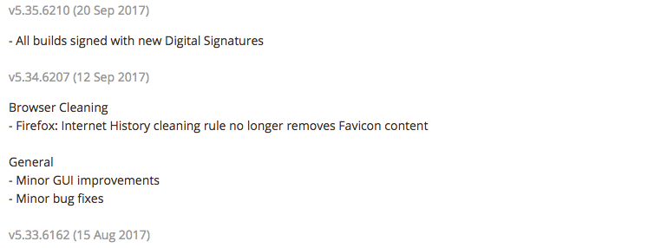
Backdoor Analysis – Stage 1
Backdoored software
CCleaner v5.33
Ccleaner Cloud v1.07.3191
CCleaner version history
Notes:
Paul

Slide 40
Backdoor Analysis – Stage 1
Backdoored software
CCleaner v5.33
Ccleaner Cloud v1.07.3191
CCleaner version history
Notes:
Paul

Slide 41
Backdoor Analysis – Stage 1
Backdoored software
CCleaner v5.33
Ccleaner Cloud v1.07.3191
CCleaner version history
Notes:
Paul

Slide 42
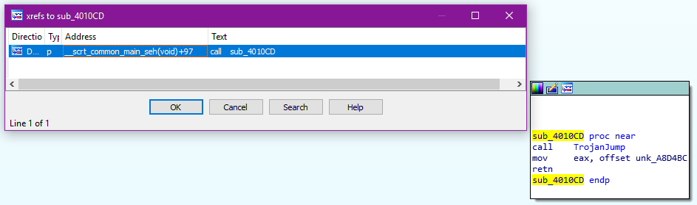
Backdoor Analysis – Stage 1
Backdoor location: runtime modification…
Notes:
Paul

Slide 43
Notes:
Paul

Slide 44
Backdoor Analysis – Stage 1
Notes:
Paul

Slide 45
Backdoor Analysis – Stage 1
Notes:
Paul

Slide 46
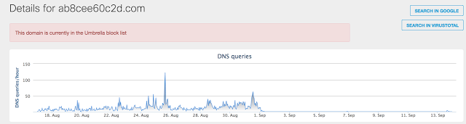
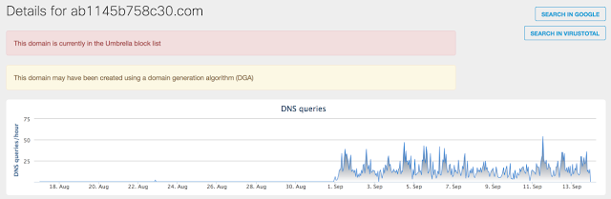
Backdoor Analysis – Stage 1
Notes:
Paul

Slide 47
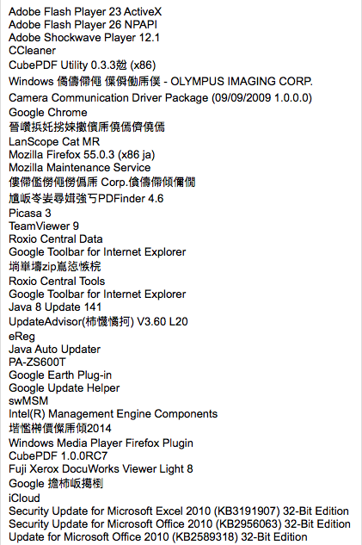
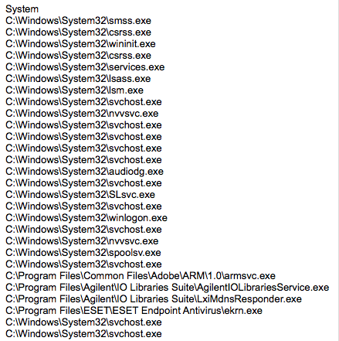
Backdoor Analysis – Stage 1
Machines registration: guid, IP address, MAC address…
Installed Programs
Process List
Notes:
Paul

Slide 48
Backdoor Analysis – Stage 2
Some selected compromised systems received a stage 2: GeeSetup_x86.dll
GeeSetup_x86.dll:
Drops TSMSISrv.dll
x86 : trojanized VirtCDRDrv.dll (VirtCDRDrv Corel tool)
x64 : trojanized EFACli64.dll (SymEFA Symantec Endpoint)
Not signed
Creates registry keys (encoded PE)
Notes:
Paul

Slide 49
Backdoor Analysis – Stage 2
Trojanized binary: runtime patching
x64 : __security_init_cookie
Display limitation with IDA Pro
More information: http://blog.talosintelligence.com/2017/10/disassembler-and-runtime-analysis.html
Notes:
Paul

Slide 50
Backdoor Analysis – Stage 2
Trojanized binary: runtime patching
x64 : __security_init_cookie
Display limitation with IDA Pro
Notes:
Paul

Slide 51
Backdoor Analysis – Stage 2
Trojanized binary: runtime patching
x64 : __security_init_cookie
Display limitation with IDA Pro
Notes:
Paul

Slide 52
Backdoor Analysis – Stage 2
The purpose additional malicious code:
Decode a PE stored in registry HKLM\Software\Microsoft\Windows NT\CurrentVersion\WbemPerf\001 HKLM\Software\Microsoft\Windows NT\CurrentVersion\WbemPerf\002 HKLM\Software\Microsoft\Windows NT\CurrentVersion\WbemPerf\003 HKLM\Software\Microsoft\Windows NT\CurrentVersion\WbemPerf\004
The purposes of this new PE:
Call a new CC (IP generated from Github & wordpress)
Get a new PE and execute it from memory…
Notes:
Paul

Slide 53
Ccleaner stage 1 dll
Missl backdoor – APT17/Group 72
Notes:
Paul

Slide 54
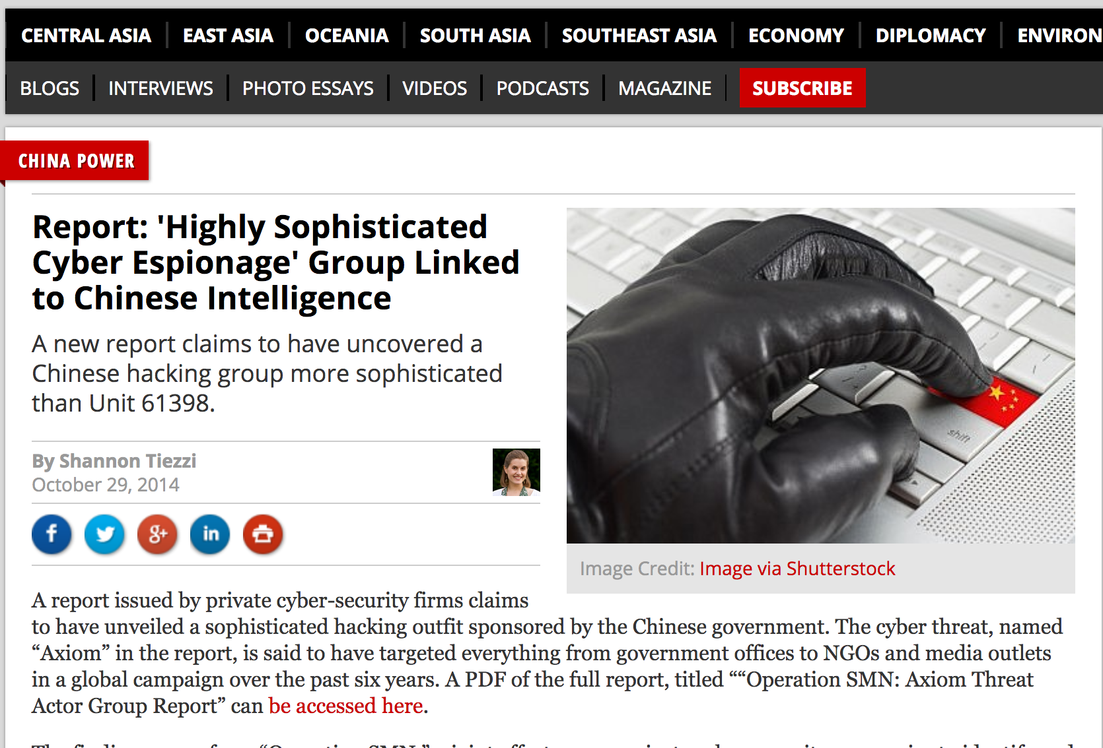
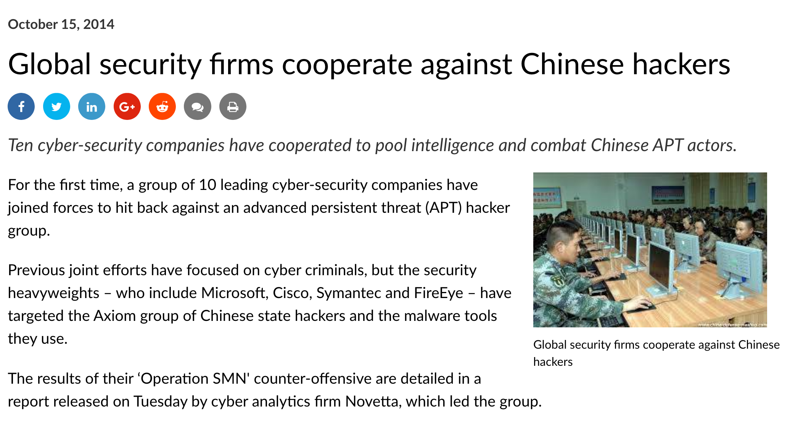
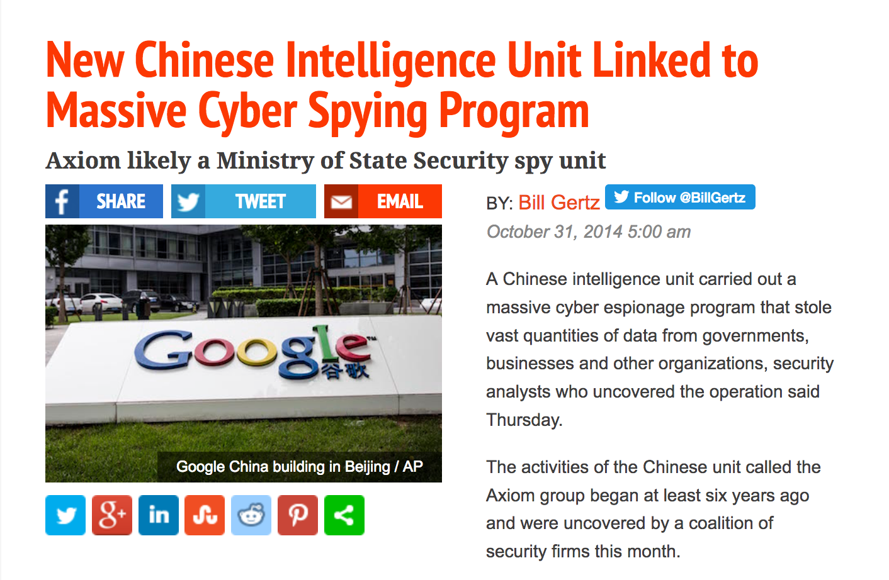
What is Group 72
Operation SMN
APT 17
Axiom
https://blogs.cisco.com/security/talos/threat-spotlight-group-72

Slide 55
Command and Control Investigation

Slide 56
Command and Control Investigation
PHP panel with MySQL database
Notes:
Paul

Slide 57
Command and Control Investigation
If the requests don’t look good
Notes:
Paul

Slide 58
Command and Control Investigation
Configuration file
Notes:
Paul

Slide 59
Command and Control Investigation
Compromised machine registration
Notes:
Paul

Slide 60
Command and Control Investigation
Shellcodes
Notes:
Paul

Slide 61
Command and Control Investigation
Targets list
Notes:
Paul

Slide 62
Command and Control Investigation
Targets list
Notes:
Paul

Slide 63
Command and Control Investigation
Database investigation: 3 tables
Server – Main table with all the data concerning stage 1 compromised machines
OK – table with selected machines / Stage 2 payload delivered
GET – Empty table
Only 4 days of data…
Only 1/5 CC
Notes:
Paul

Slide 64
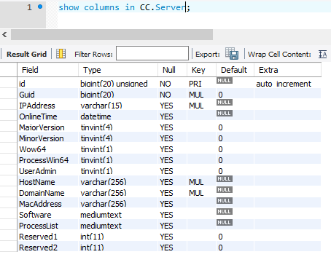
Command and Control Investigation
Server table:
Notes:
Paul

Slide 65
Command and Control Investigation
Server table:
Notes:
Paul

Slide 66
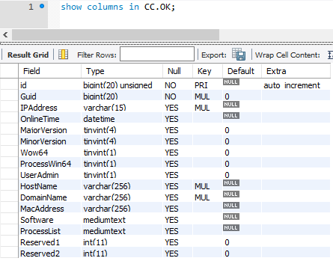
Command and Control Investigation
OK table:
Notes:
Paul

Slide 67
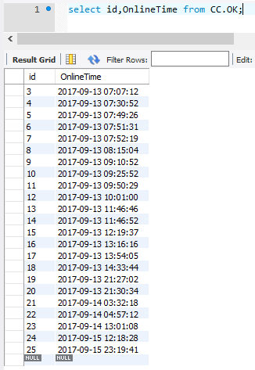
Command and Control Investigation
OK table:
Notes:
Paul

Slide 68
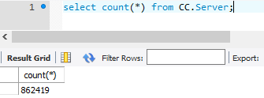
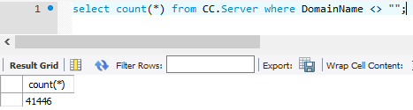
Command and Control Investigation
Let’s play with statistics…
Notes:
Paul

Slide 69
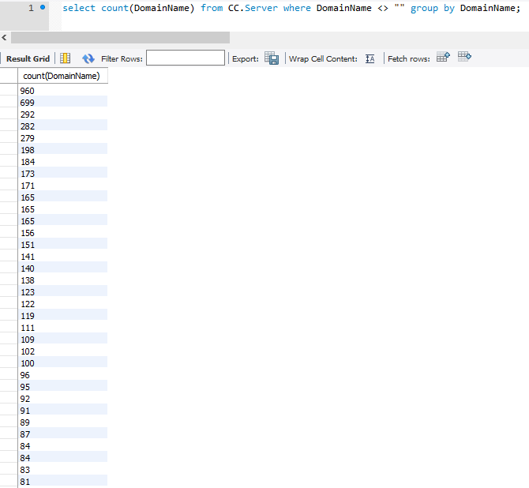
Command and Control Investigation
Let’s play with statistics…
Notes:
Paul

Slide 70
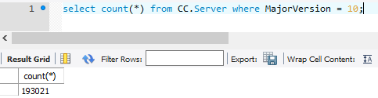
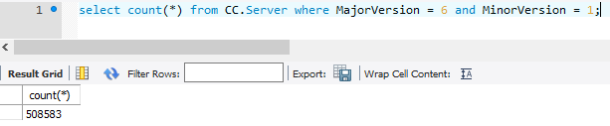
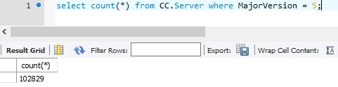
Command and Control Investigation
Let’s play with statistics…
Win 10
Win 7
Win XP
Notes:
Paul

Slide 71
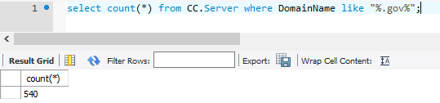
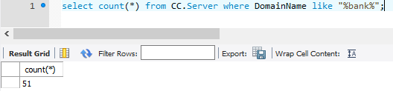
Command and Control Investigation
Let’s play with statistics…
Notes:
Paul

Slide 72


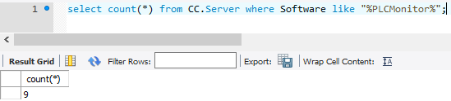
Command and Control Investigation
Let’s play with statistics…
Notes:
Paul

Slide 73
Conclusion

Slide 74
Notes:
Paul

